Slide 1
Exercise 1
Design a class named MyInteger. The class contains the following:
An int data field named value that stores the int value represented by this object.
A constructor that creates a MyInteger object for the specified int value.
A constant get function that return the int value.
Constant functions isEven(), isOdd(), isPrime() that return true if the value is even, odd, or prime, respectively
Static functions isEven(int), isOdd(int), isPrime(int) that return true if the specified value is even, odd, or prime, respectively.
Static functions isEven(const MyInteger&), isOdd(const Myinteger&), isPrime(const MyInteger&) that returns true I f the specified value is even, odd, or prime, respectively.
Constant functions equals(int) and equals(const MyInteger&) that return true if the value in the object is equal to the specified value.
A static function parseInt(const string&) that converts a string to an int value.
Implement the class and write a program to test all functions in the class.

Slide 2
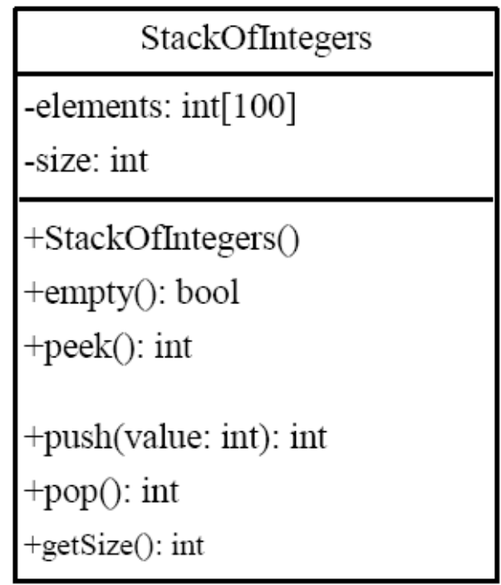
Exercise 2
A stack is a data structure that holds data in a last-in, first-out fashion. Please write a program to implement the stack of integers and test it.

Slide 3
Exercise 3
Write a program that receives a positive integer that a user inputs and displays all its smallest factors in decreasing order. For example, if the integer is 120, the smallest factors are displayed as 5, 3, 2 ,2 ,2.
提示：使用Exercise 2中设计的StackOfIntegers类来实现

